Slide 1

Faraday’s Law of Induction
The induced emf in a closed loop equals the negative of the time rate of change of the magnetic flux through the loop
Express Faraday’s and Lenz’s law
$$ℇ$$
Lenz's law
The direction of the emf induced by changing flux will (would) produce a current that generates a magnetic field opposing the flux change that produced it.

Slide 2

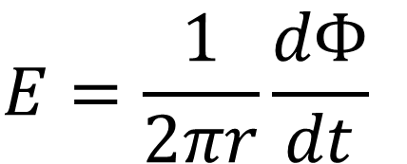
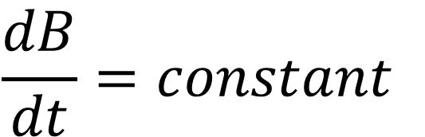
x
x
x
$$E=\frac{1}{2πr}\frac{dΦ}{dt}$$
x
x
x
l
x
x
x
x
x
x
x
An infinite plane of uniformly increasing magnetic field?
$$\frac{dB}{dt}=constant$$
x
x
x
x
What is the direction of emf ?
x
x
x
x
- No induced E field or emf !
A finite region of magnetic field could have induced E field or emf.
– the boundary matters
x
x
x
x

Slide 3
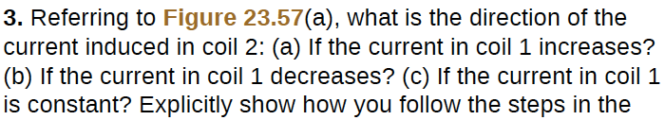
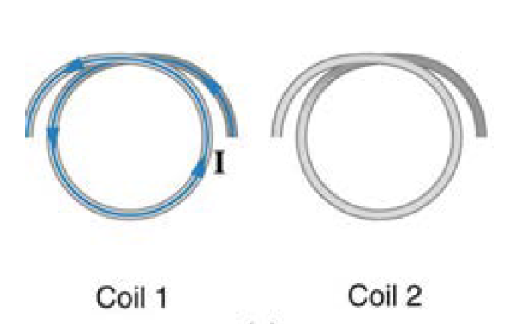
Decreasing I1
Increasing I1
I2
I2
Bind
X
Bind
B
X
B

Slide 4
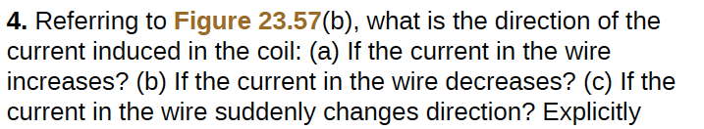
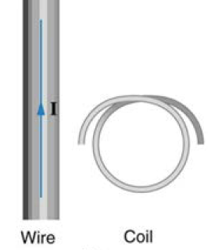
Decreasing I1
Increasing I1
I2
I2
X
Bind
Bind
X
B

Slide 5
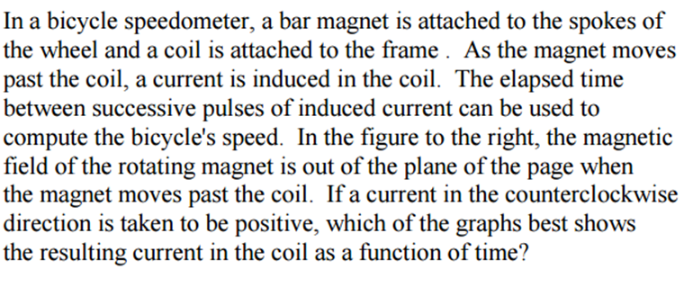
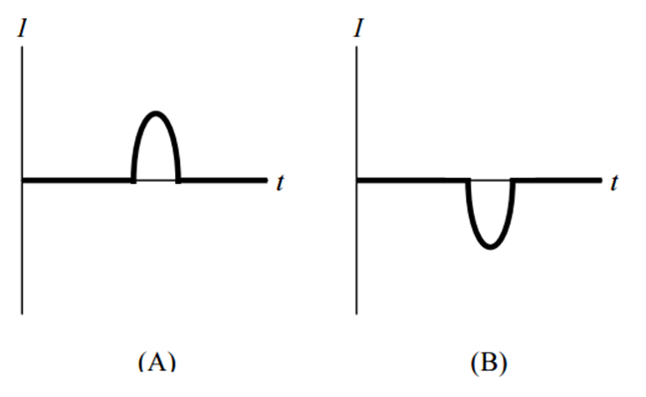
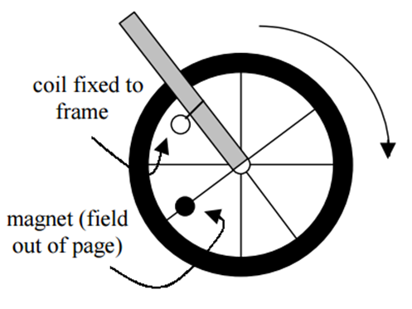
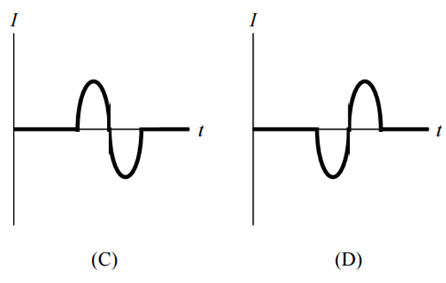

Slide 6
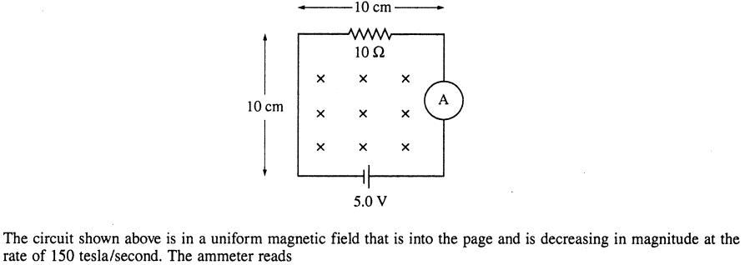


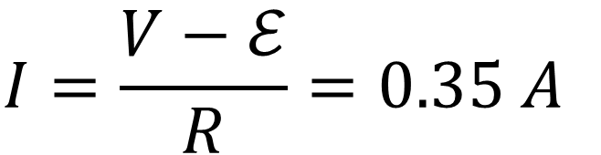

$$𝓔$$
$$V$$
$$ℰ=−\frac{dΦ}{dt}=−A\frac{dB}{dt}=1.5 V$$
$$I=\frac{V−ℰ}{R}=0.35 A$$

Slide 7
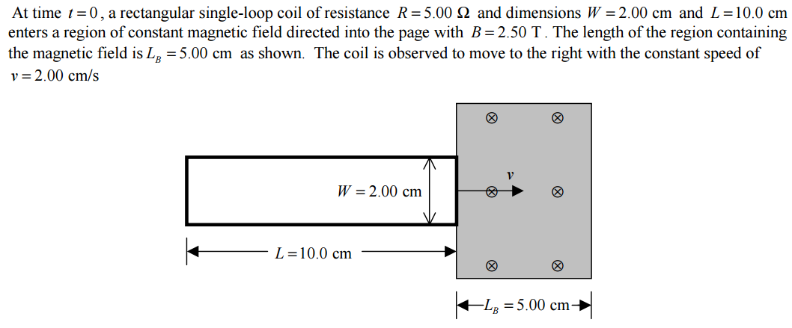
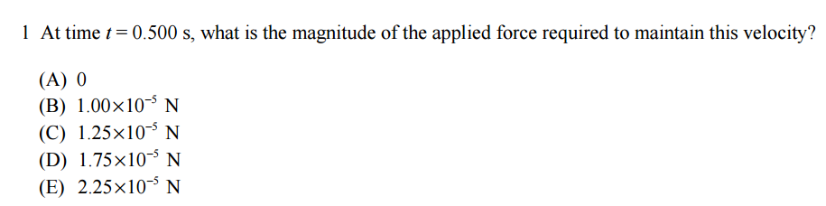

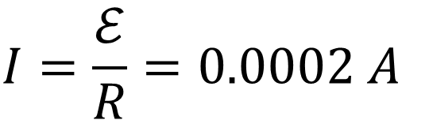
$$ℰ=Blv=0.001V$$
$$I=\frac{ℰ}{R}=0.0002 A$$
$$F=BlI=0.00001 N$$

Slide 8
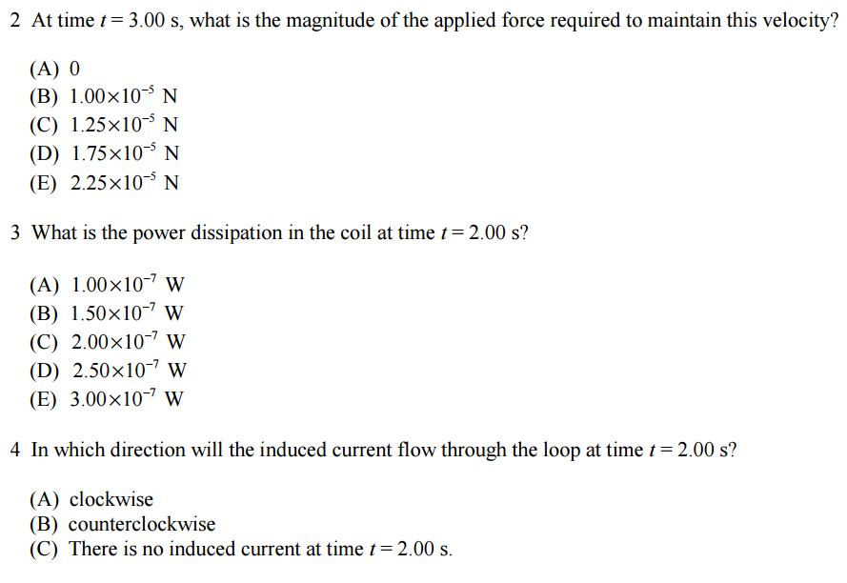
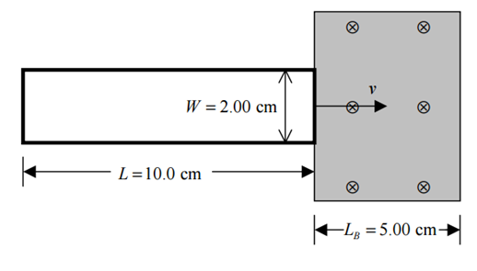

$$I$$

Slide 9
A uniform and constant magnetic field B is directed perpendicularly into the plane of the page everywhere within a rectangular region as shown above. A wire circuit in the shape of a semicircle is rotated counterclockwise in the plane of the page about an axis A. The axis A is perpendicular to the page at the edge of the field and directed through the center of the straight-line portion of the circuit. Which of the following graphs best approximates the emf ε induced in the circuit as a function of time t?

Slide 10
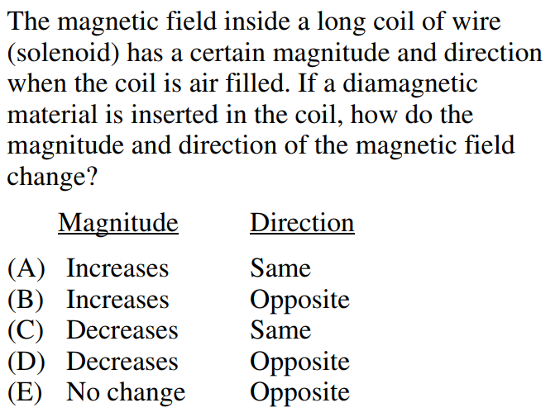


$$B=μnI$$
$$μ↓ ⟹ B↓$$
During the insertion, what is the direction of induced e.m.f in the coil?
(A) Same direction as the current
(B) Opposing the current
(C) No induced e.m.f.
(D) Depending on the winding direction of the coil

Slide 11
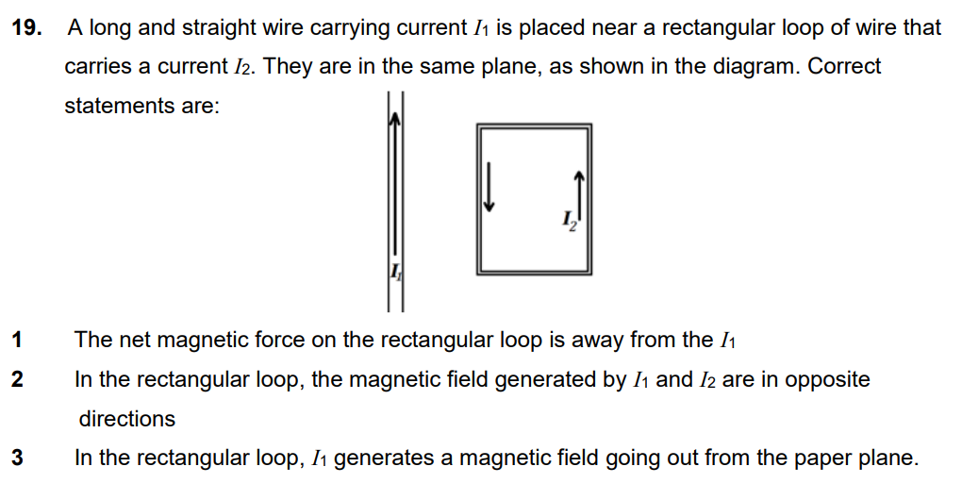

Slide 12
y
I
A conducting rectangular loop moves with constant velocity v in the -y direction and a constant current I flows in the +x direction as shown
x
x
x
x
x
x
x
x
I_{induced}
x
x
x
x
x
x
v
x
What is the direction of the induced current in the loop?
(a) ccw
(b) cw
(c) no induced current
The flux through this loop does change in time since the loop is moving from a region of higher magnetic field to a region of lower magnetic field
Therefore, by Lenz’s Law, an emf will be induced which will oppose the change in flux
Current is induced in the clockwise direction to restore the flux

